Slide 1
Capstone Project
Western countries Financial Data
Submitted
By
Deepak

Slide 2
INTRODUCTION
It’s a Manufacturing company that Manufacture different Items because I Assume through Manufacturing Price
There is two years of data
The dataset talks about sales of 6 products across 5 nations and 5 segments in 2013 & 2014.
The discount has been categorized as small, medium and high.
It also informs us of the manufacturing price and sales price including the discount.
Product meaning
Velo | Cycle
Paseo | Tissue
VTT | Packaging material
Carretera | Road
Amarilla | Similar to Pickle
Montana | Furniture

Slide 3
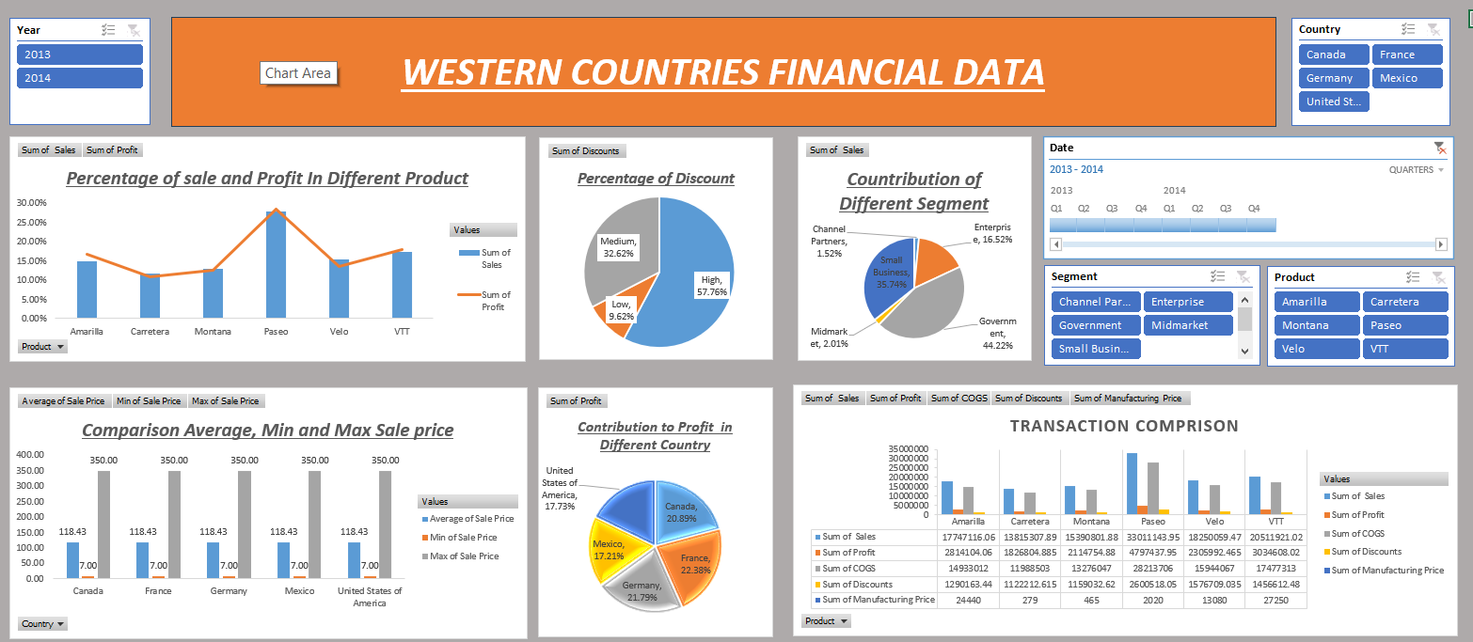
EXCEL DASHBOARD

Slide 4
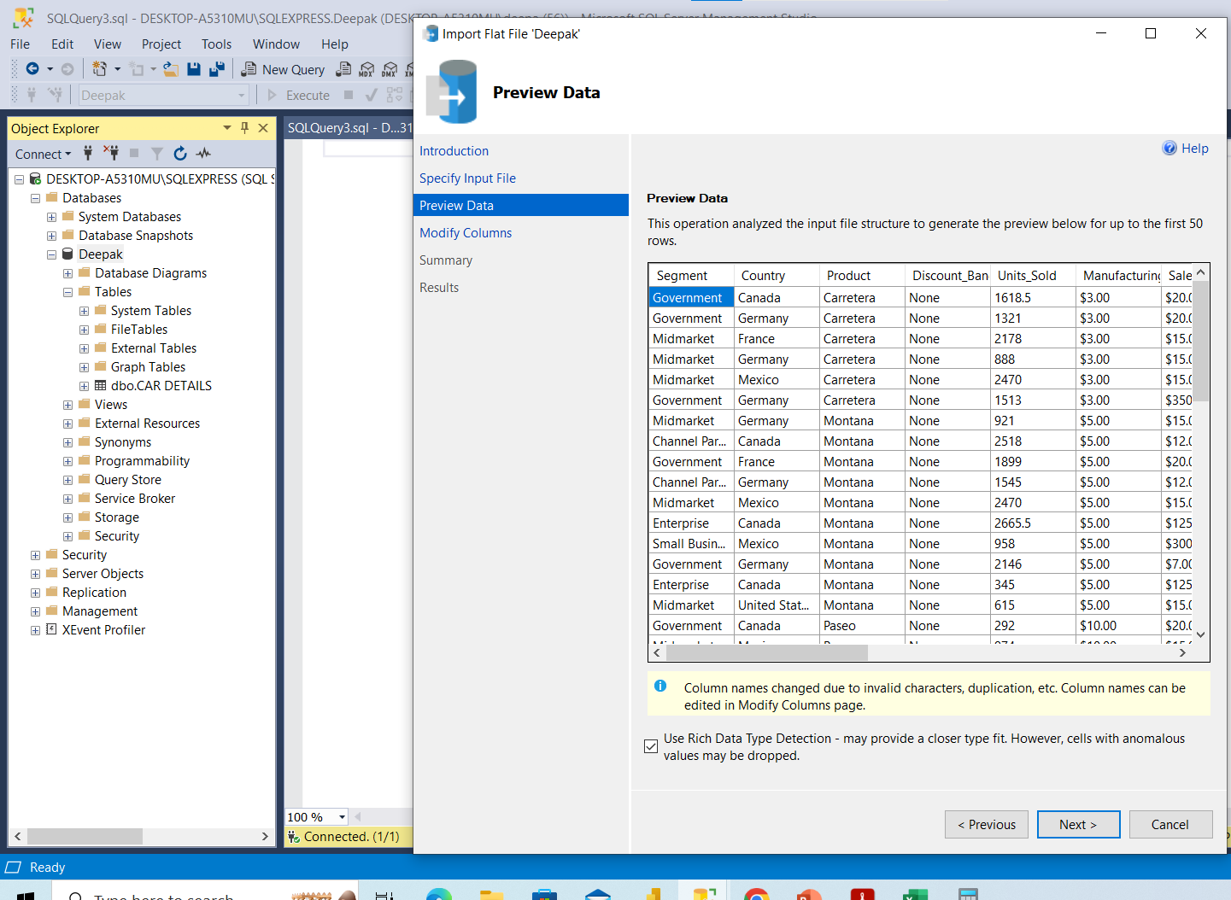
Import data from csv to SQL Server

Slide 5
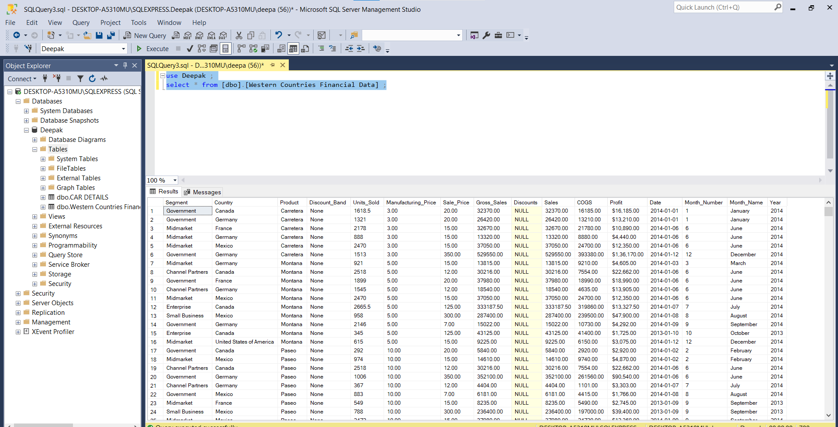
Show data in SQL Server
Using Query
1. use Deepak ;
2. select * from [dbo].[Western Countries Financial Data] ;
First Query is use Databased
Second Query is Show whole Data

Slide 6
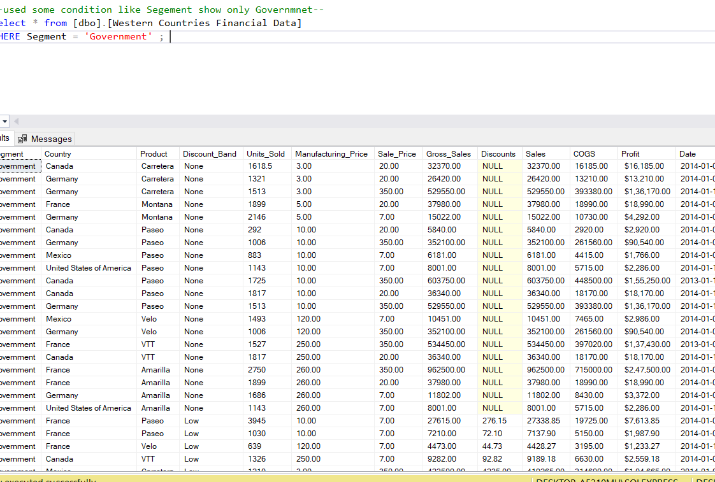
Query to show only Government Segment
--used some condition like Segement show only Governmnet—
Select * from [dbo].[Western Countries Financial Data]
WHERE Segment = 'Government' ;

Slide 7
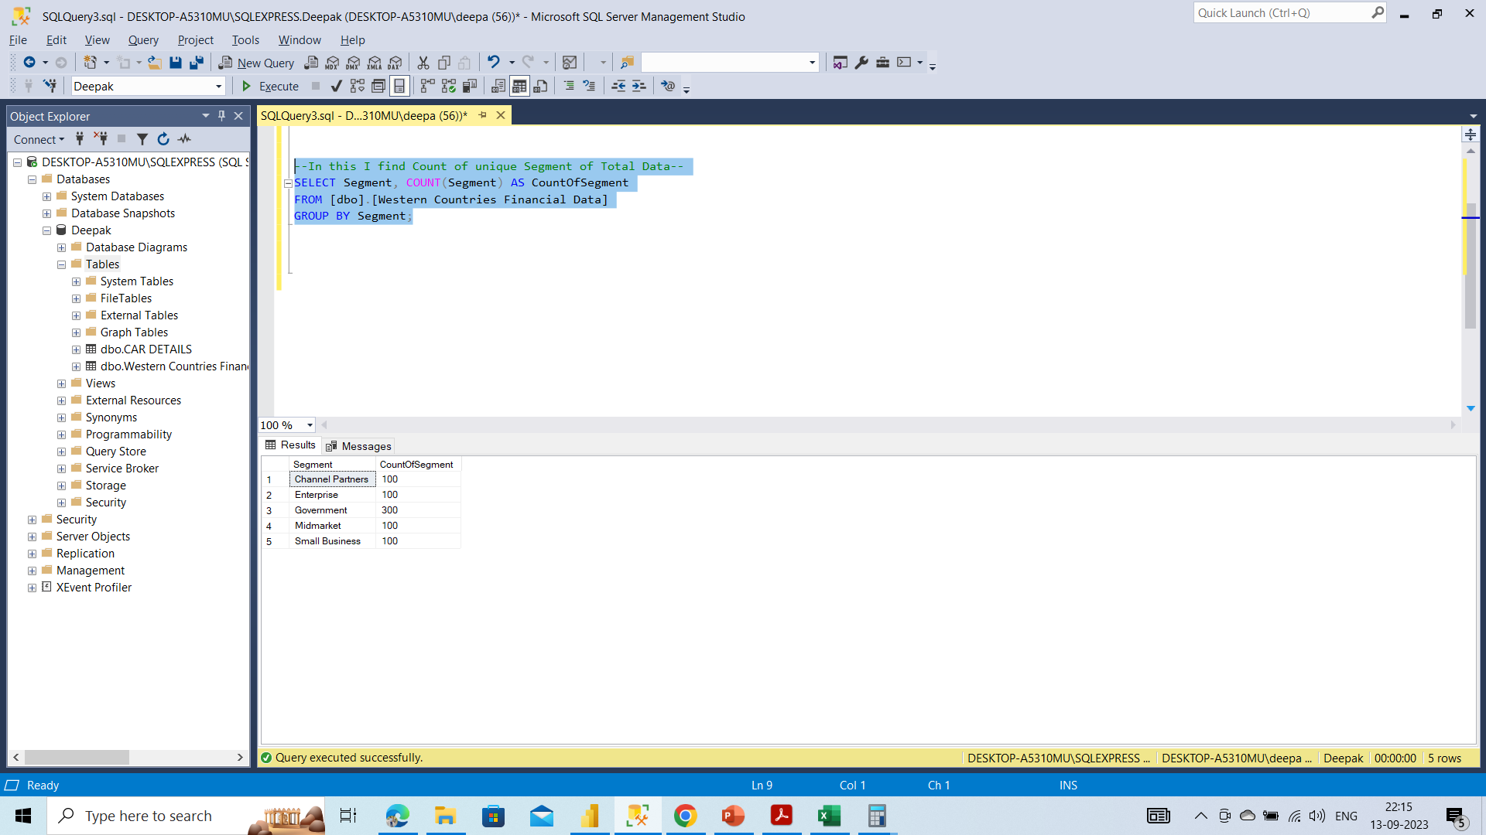
Know about Count of Data with Different Segment
--In this I find Count of unique Segment of Total Data--
SELECT Segment, COUNT(Segment) AS CountOfSegment
FROM [dbo].[Western Countries Financial Data]
GROUP BY Segment;

Slide 8
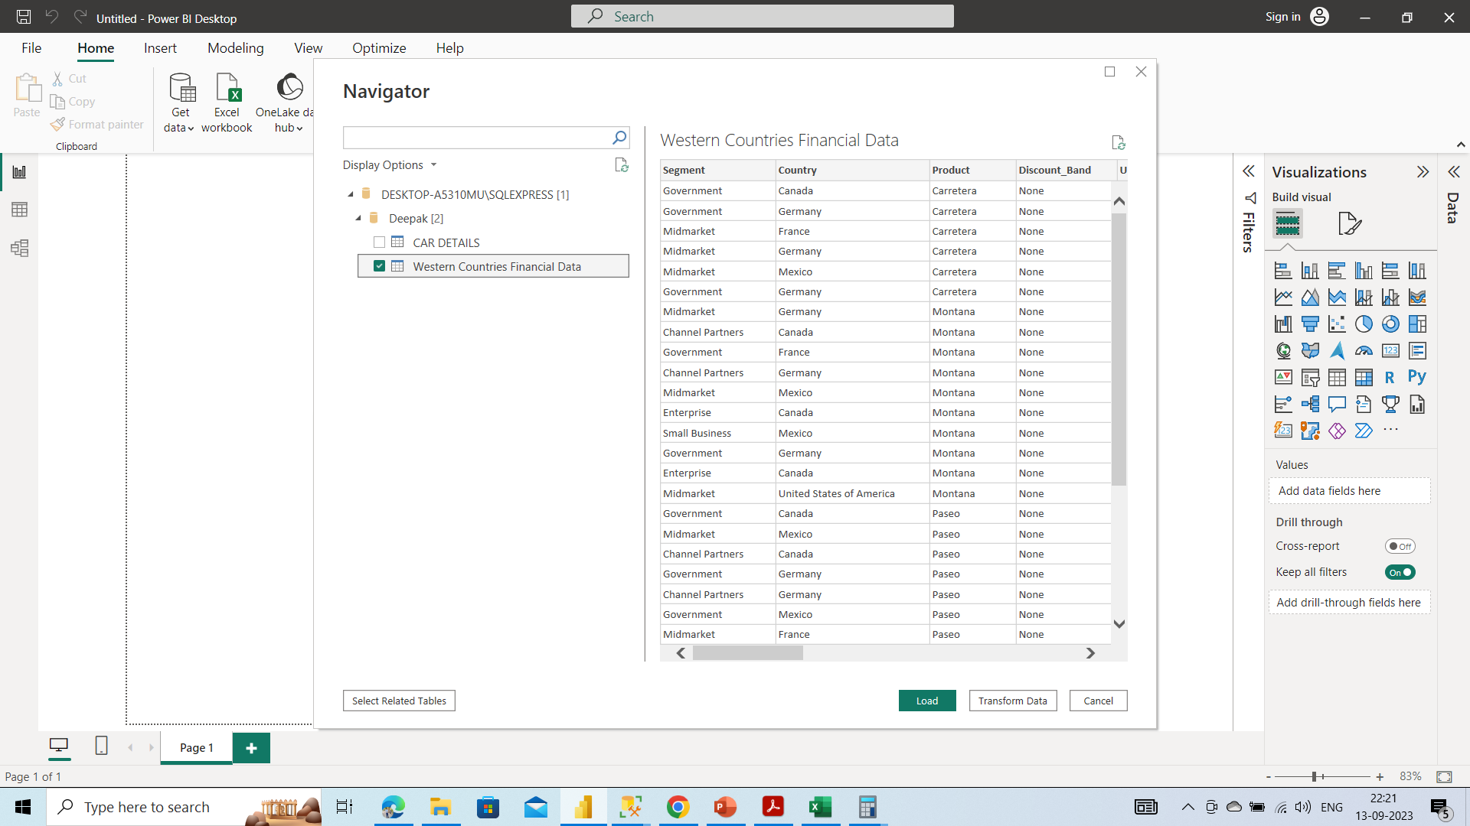
Import Data From SQL Server TO POWER BI

Slide 9
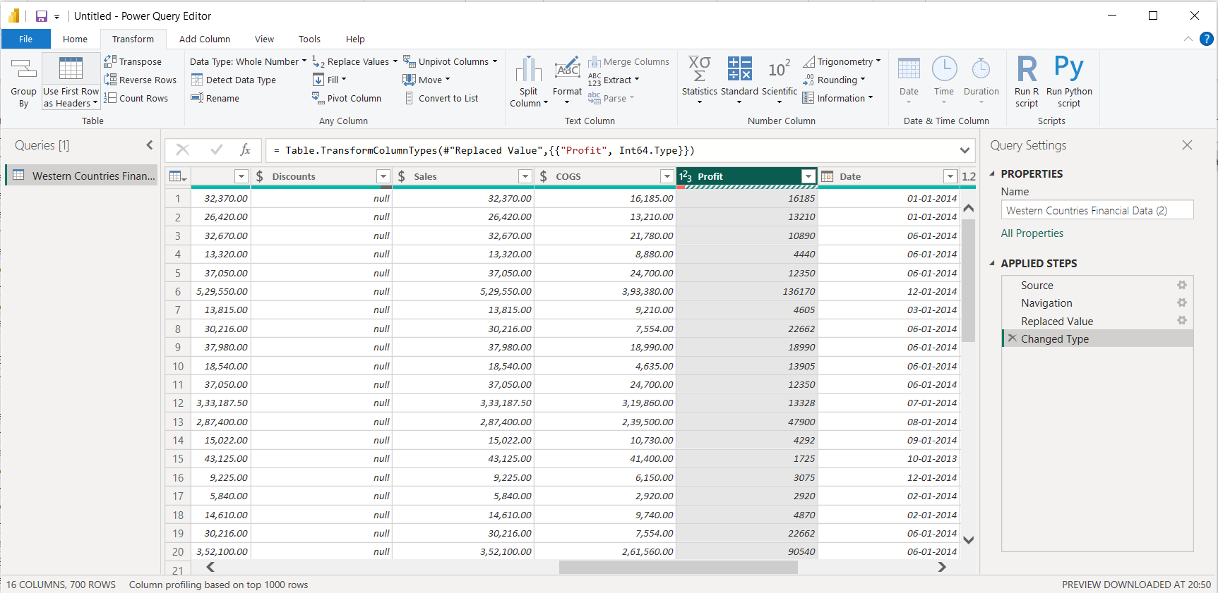
Transform the Data Profit Column Change From Text into Number

Slide 10
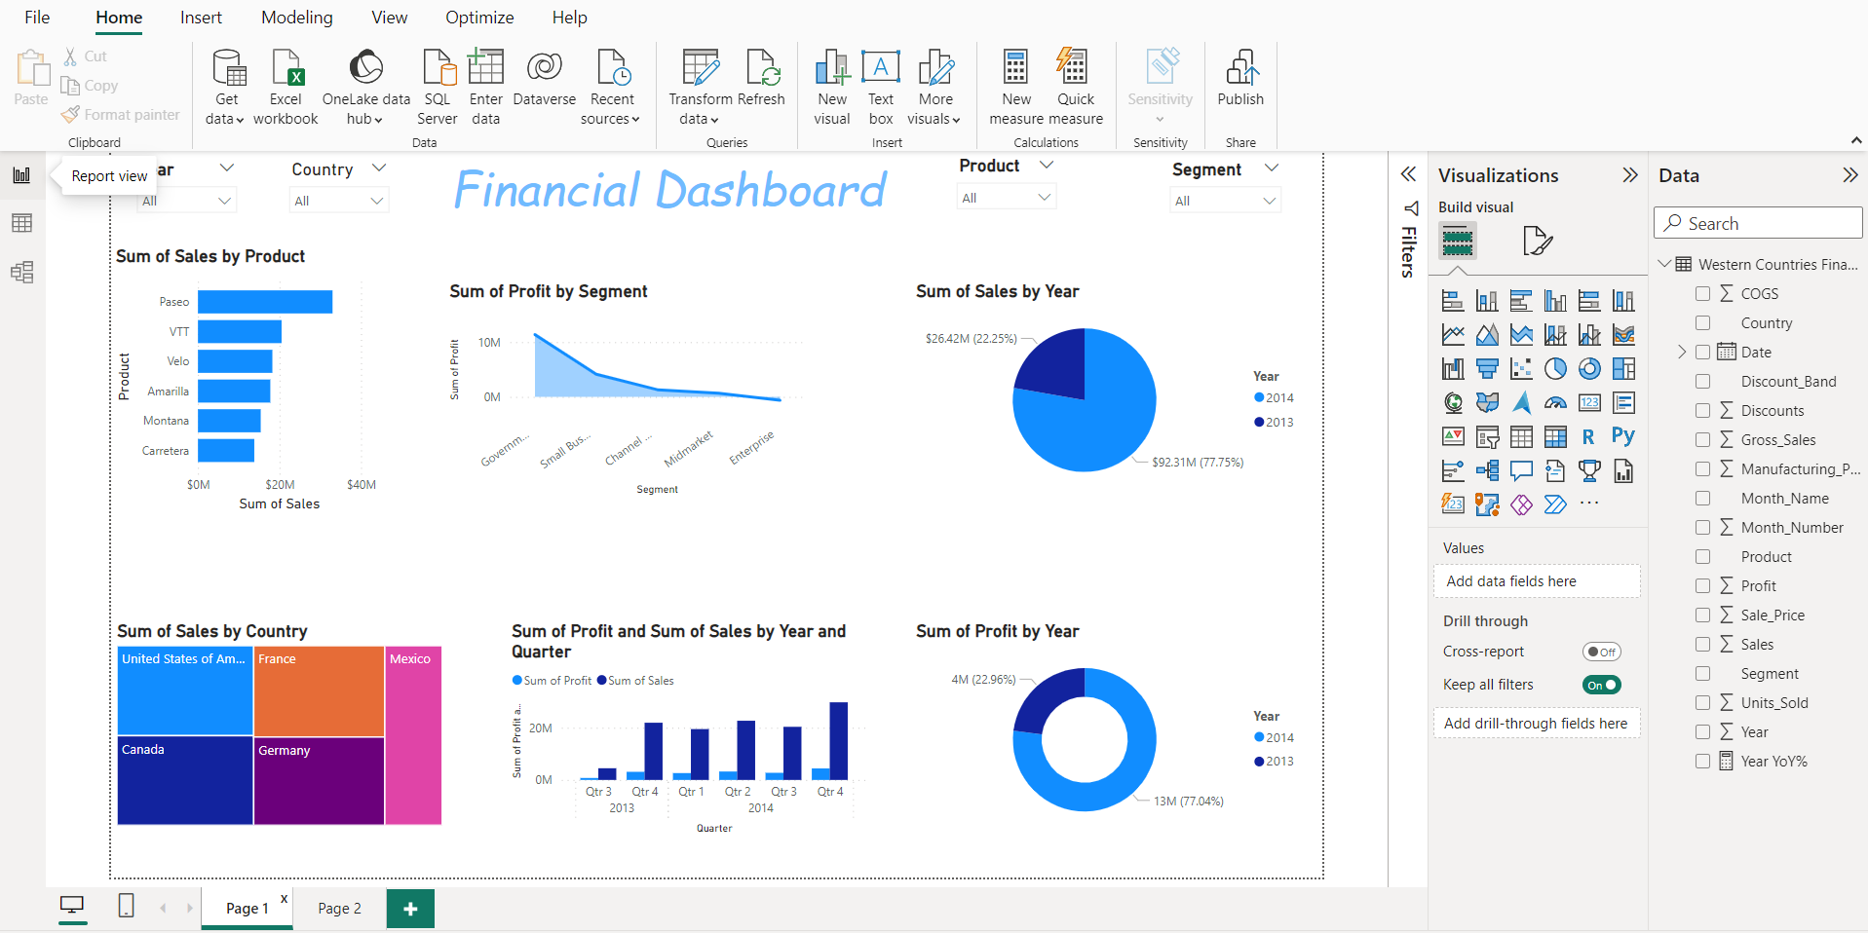
Dashboard In Power BI

Slide 11
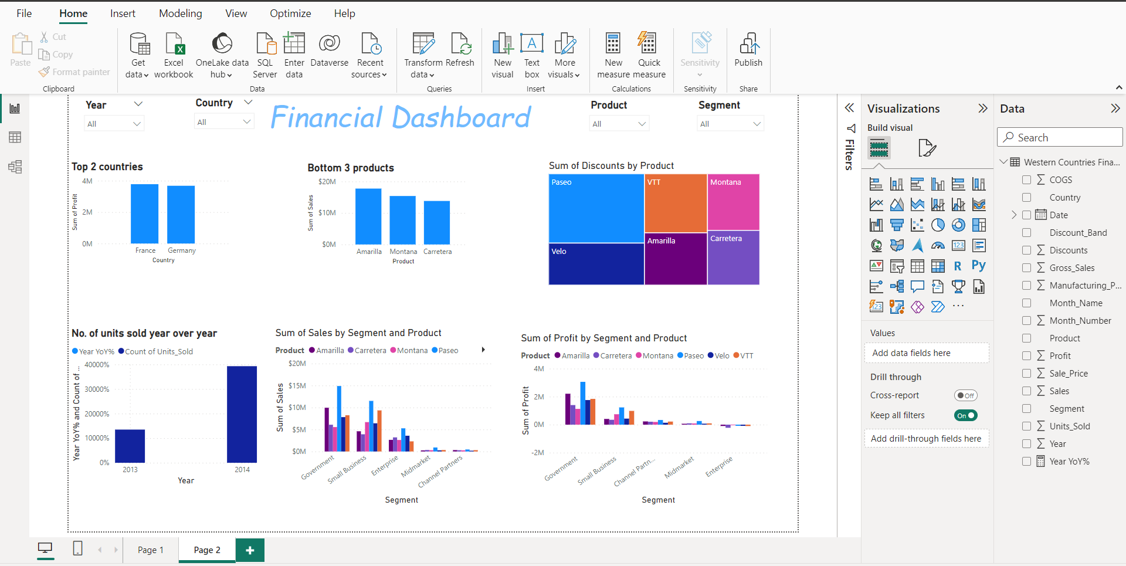
Dashboard In Power BI 2

Slide 12
Conclusion and Inferences in Both Dashboard Excel And Power BI
In 2013, Velo product sales were highest, and the Highest profit Contribution for Velo products in Germany was 44% and lowest contribution in Canada 2.88%. However, it's worth noting that there are outliers in the Velo product prices, with a minimum price of 15, an average price of 162, and a maximum price of 350.
In both years, the highest sales were achieved by Paseo, with Canada leading in terms of Profit 26.37% and lowest one is Germany 15.52% With Min Price 7 Max Price 350 Average Price 106.93 . Various discounts were applied, with the highest discount being 53%, followed by 11% and 29%.

Slide 13

Thankyou

